Slide 1
Lecture 12: The wider research toolbox
The right tool for the job Dr. Gordon Wright

Slide 2
Rummaging around in the Toybox

Slide 3
Introduction
I want to briefly talk about some methods we haven’t covered yet.
And to a certain extent, the topic doesn’t matter, soooo..
I’m going to tell you about a few of my own studies for a change.
Key objective: Show how different methods can bring different insights.
AND: To give you some ideas for next year

Slide 4
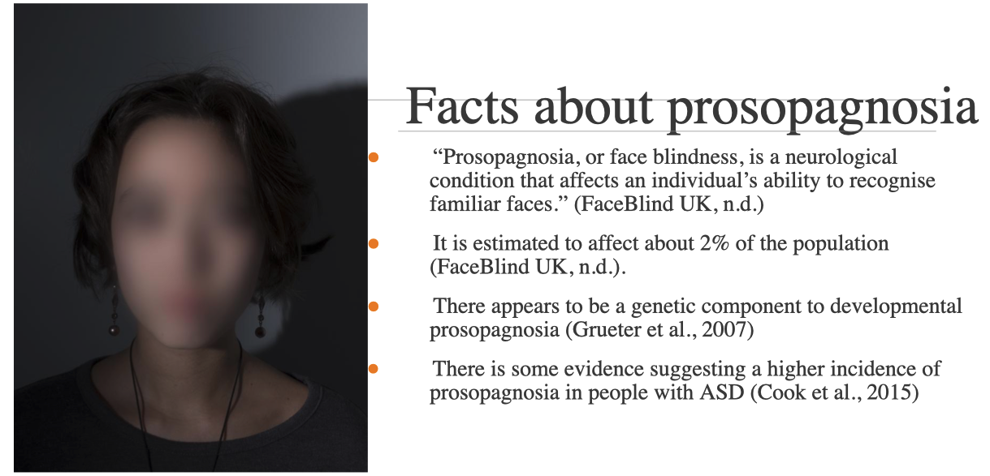
Mixing Methods
Quantitative Research has been our primary focus until this term
You’ve started hearing about Qualitative Methods with Hilary
Qualitative Questions

Slide 5
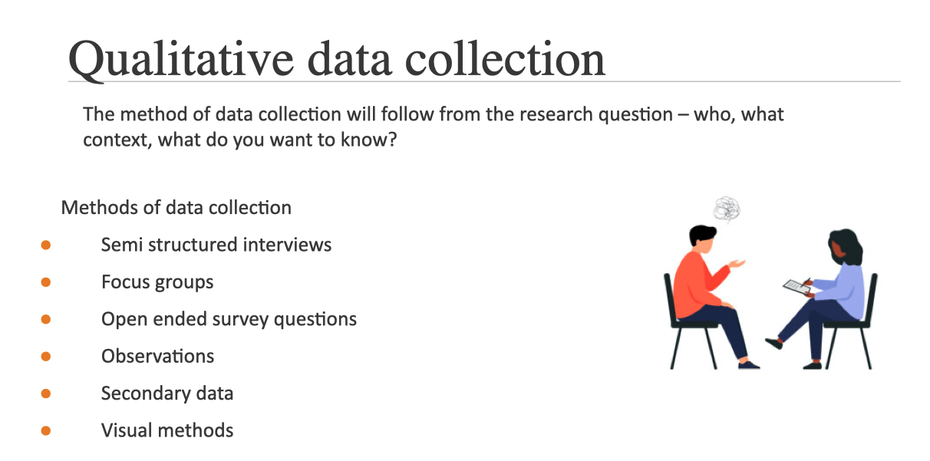
Qualitative Data Collection

Slide 6
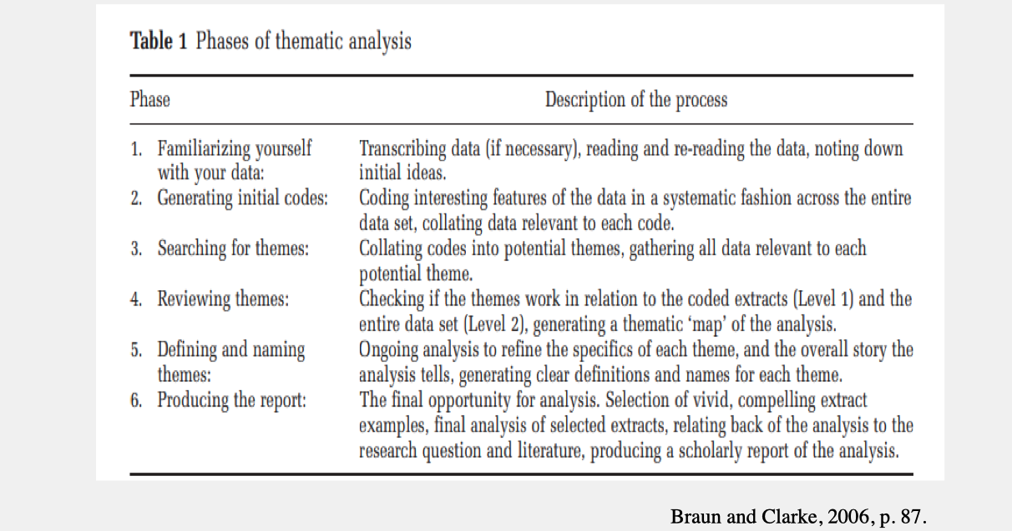
Qualitative Analysis

Slide 7
Let’s start with deception

Slide 8
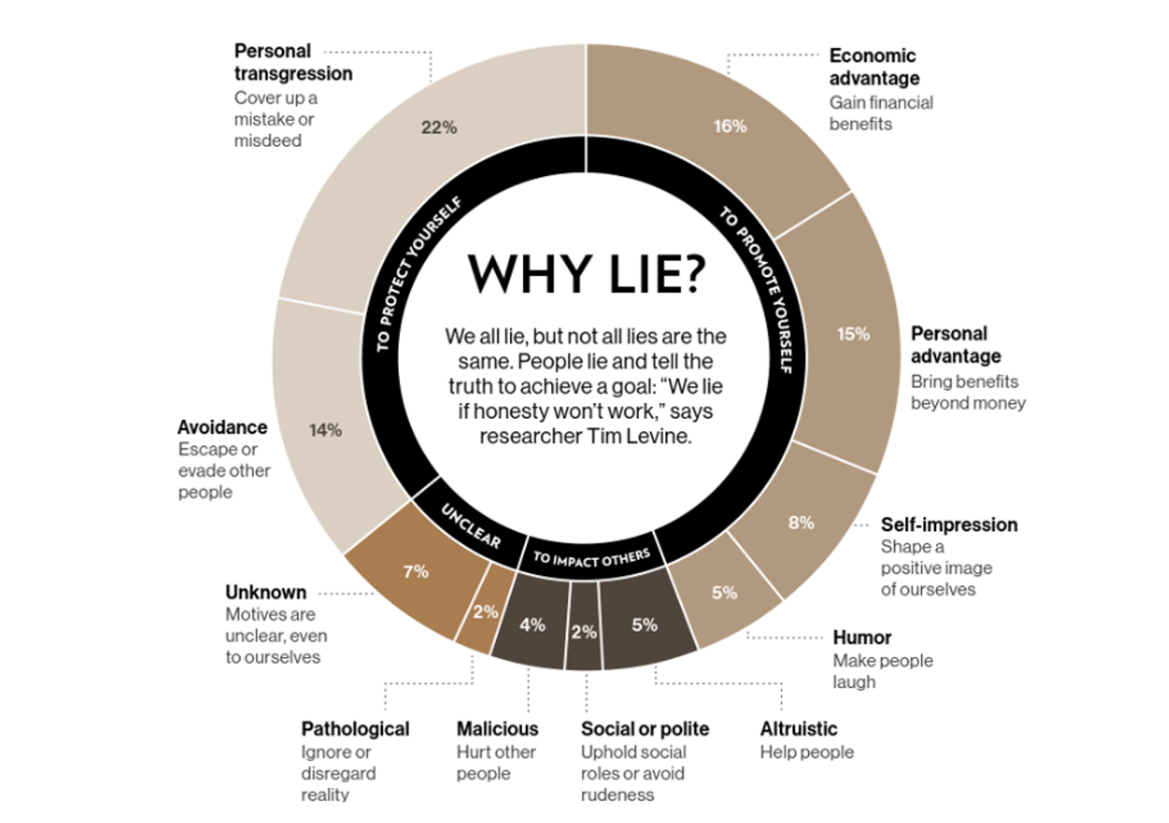
So why do people lie?

Slide 9
Levine (2010)

Slide 10

BBC Horizon: The Honesty Experiment

Slide 11


Slide 12
So how do you explore such a broad range of contexts/motives?
One simple answer is to blend methods based on the requirements of the study.

Slide 13
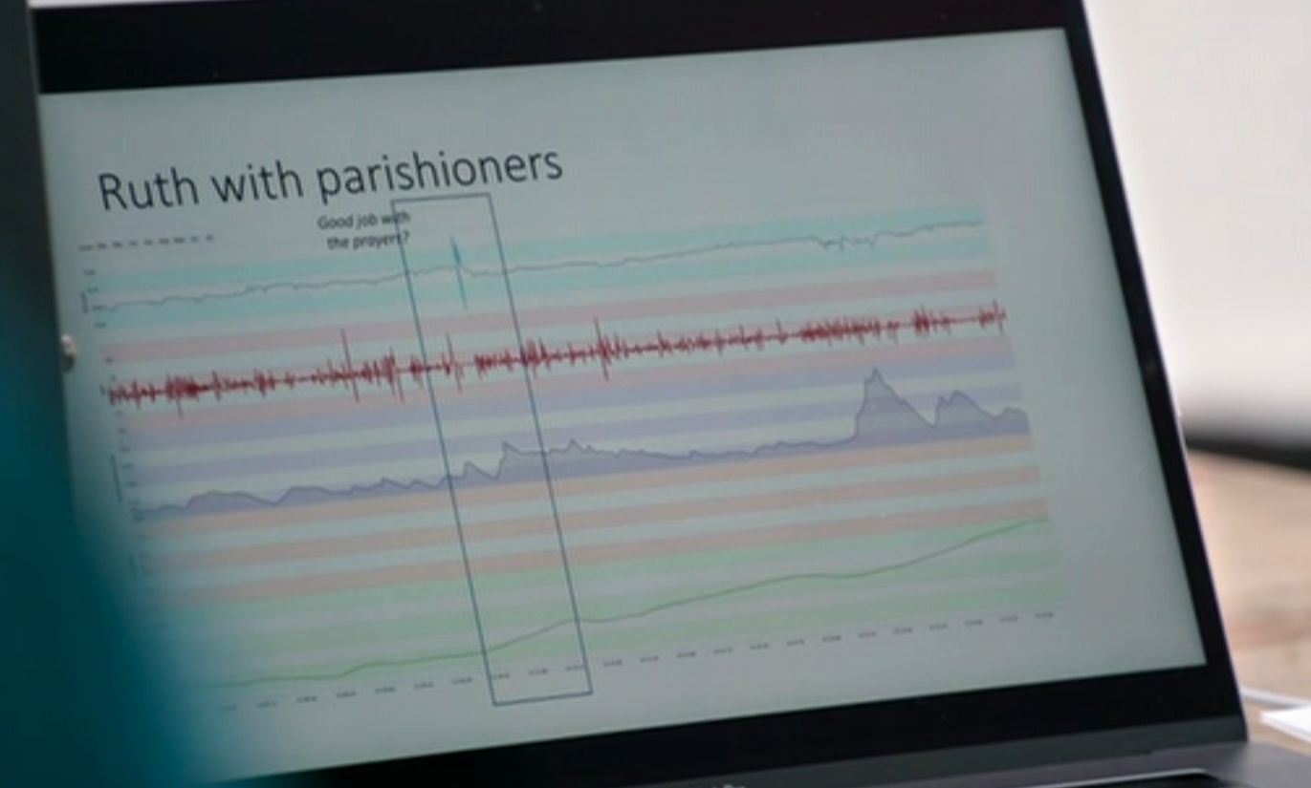

A rare opportunity to combine methods! Thanks BBC!

Slide 14
In case I missed any methods, here is the full list
Behavioural Indices (akin to polygraph - GSR/EDA, Heart Rate, Blood Pressure, Accelerometry)
Language - Linguistic Inquiry & Word Count - Language Style Matching
Paraverbal behaviour - non-speech utterances, turn-taking, chronometrics
Non-Verbal Behaviour - Posture, Facial Expressions, Eye behaviour, self-touching etc
Full body motion Capture (XSens - 17 accelerometers across the body)

Slide 15
continued…
Daily Diary and Reflective Prompts
Self/Other Triangulation
Interviews/Video-Reflection
Case Studies
AND viewer feedback!

Slide 16
Case Study #2 - Quarterlife Crisis

Slide 17
Interpretative Phenomenological Analysis

Slide 18
Interpretative Phenomenological Analysis (IPA)
Definition: IPA is a qualitative research approach that focuses on exploring how individuals make sense of events. Focused on understanding individuals’ subjective experiences and perspectives regarding specific situations.
The core of this approach lies in comprehending how people perceive and make sense of events, rather than examining the external events themselves. It demands ‘double hermeneutics’
Methodology:
Involves detailed, reflective examinations of participants’ lived experiences.
Typically uses small, purposively selected samples to provide in-depth insights.
Data is usually collected through semi-structured interviews or personal diaries.

Slide 19
Interpretative Phenomenological Analysis (IPA) 2
Analysis:
Emphasizes the interpretative role of the researcher (hermeneutics) in making sense of participants’ experiences (double hermeneutics).
Involves a cyclical process of reading and re-reading data, coding, and theme development.
Seeks to uncover the meaning and significance of experiences from the participant’s perspective.
Application:
Particularly useful in psychology for understanding complex, emotionally laden, and deeply personal experiences.
Aims to provide a detailed, nuanced
Case Study - Quarterlife Crisis.

Slide 20
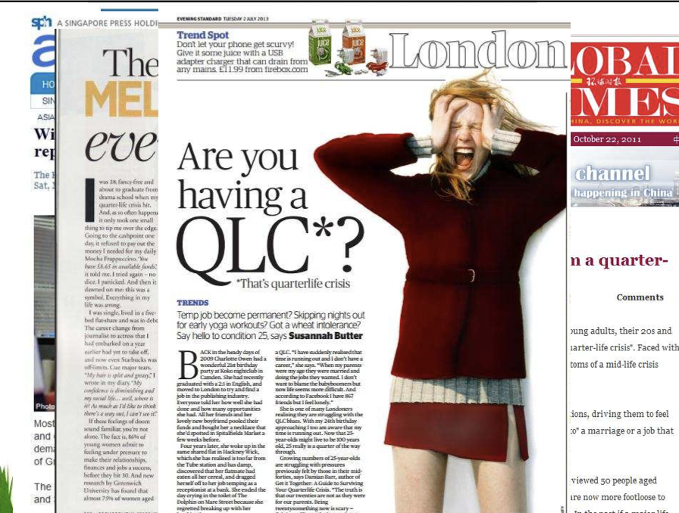
Quarterlife Crisis?
Robinson & Wright (2013) Robinson et al. (2013)

Slide 21
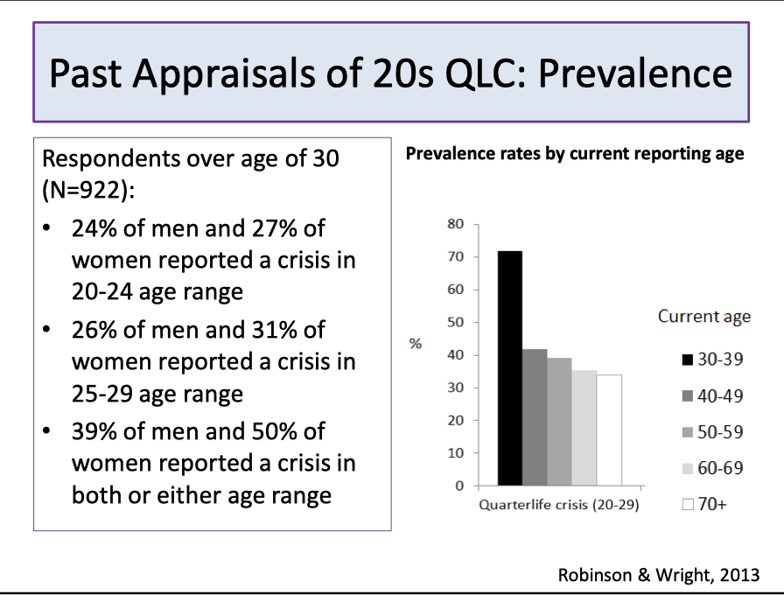
Is it serious?

Slide 22
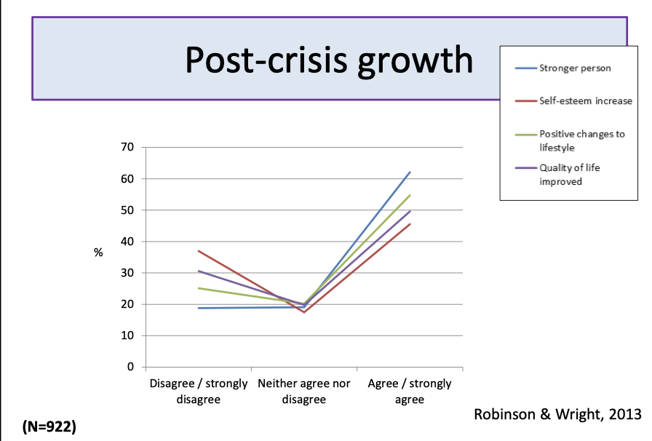
But it can’t be all bad, surely?

Slide 23
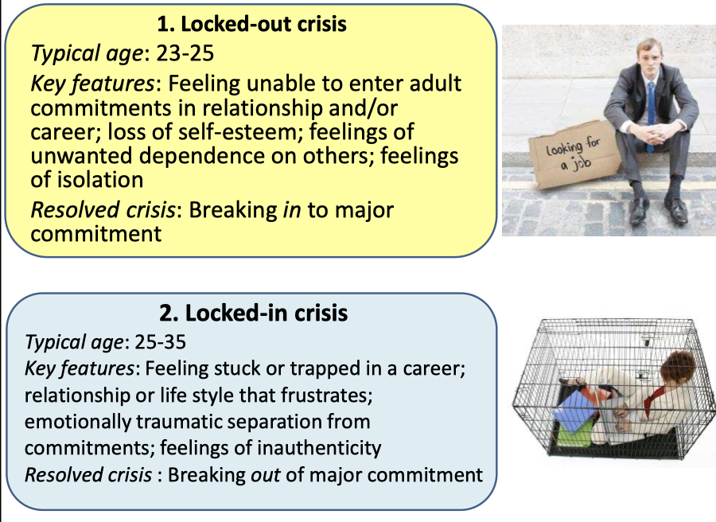
Types of Crisis Episode

Slide 24
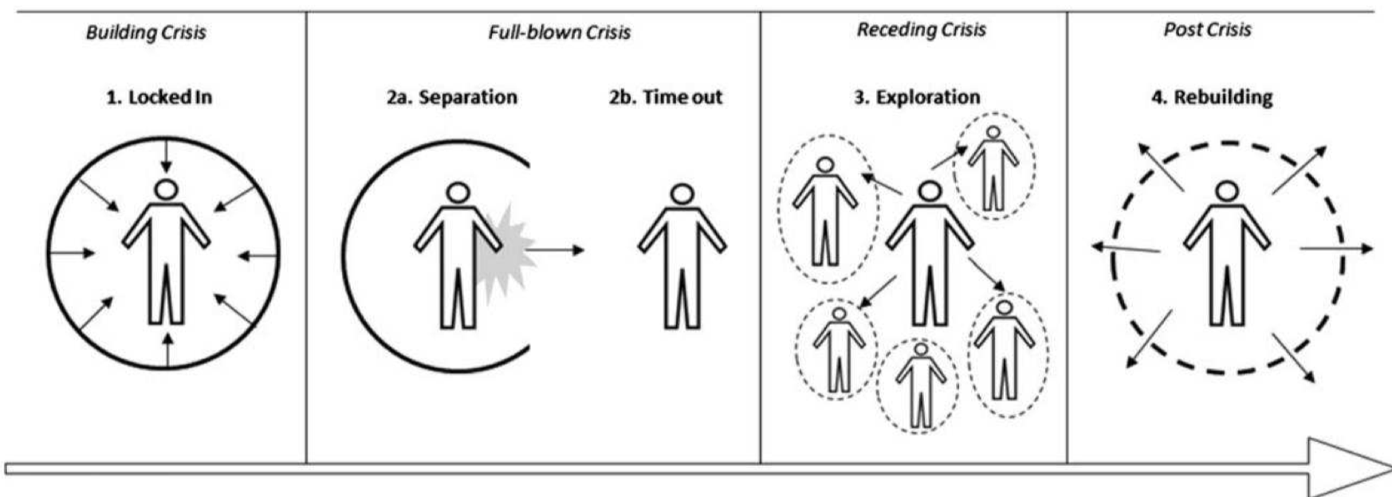
Phase Model

Slide 25
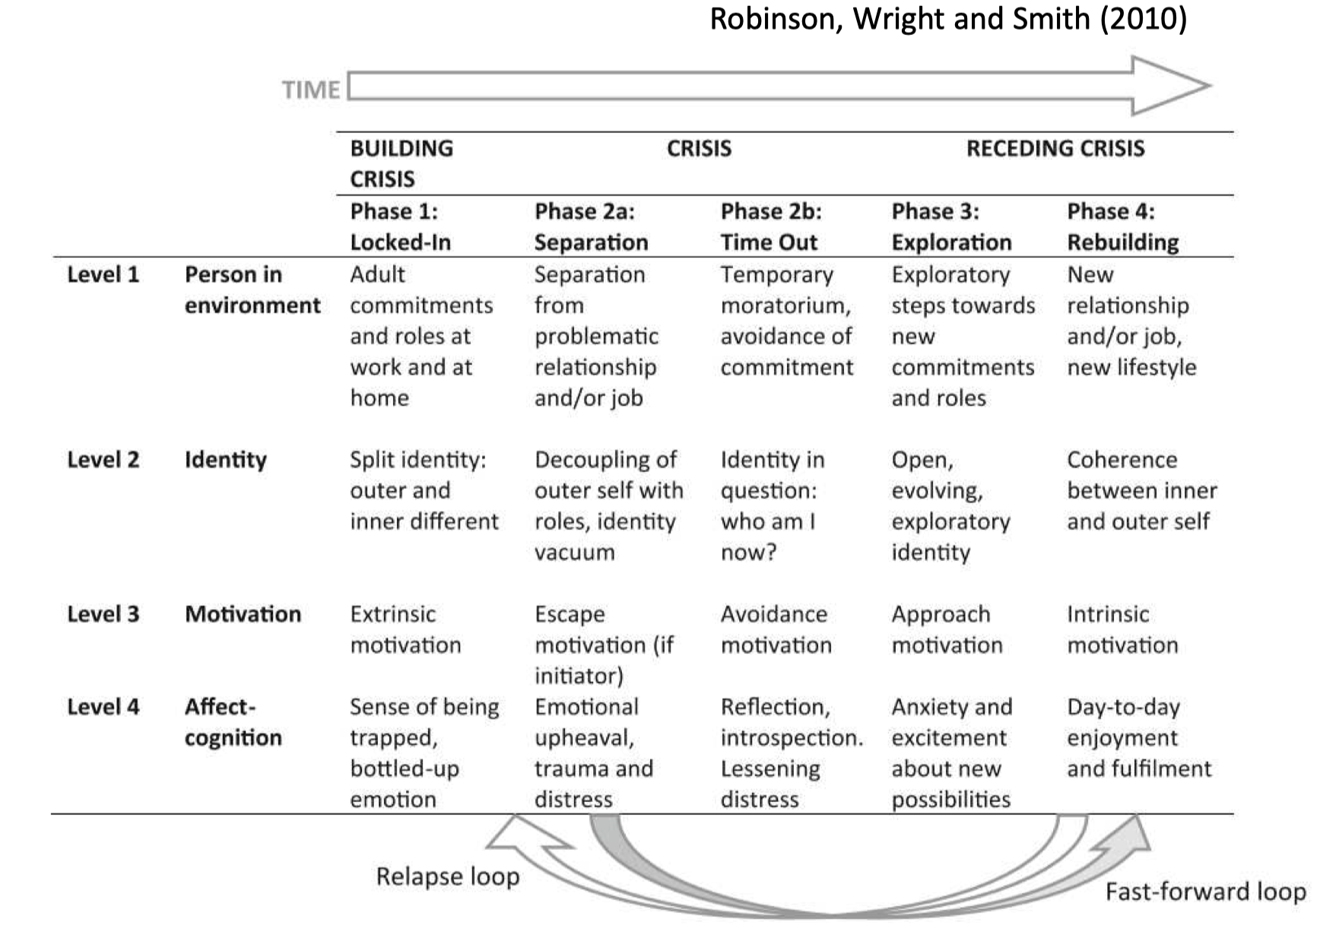
Themes / Descriptors

Slide 26
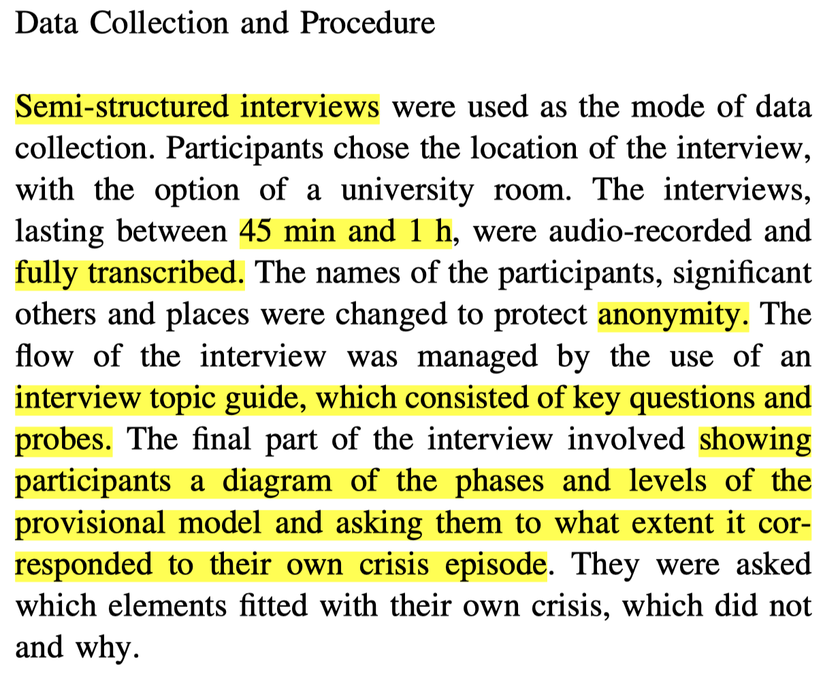
Data Collection Robinson et al. (2013)

Slide 27
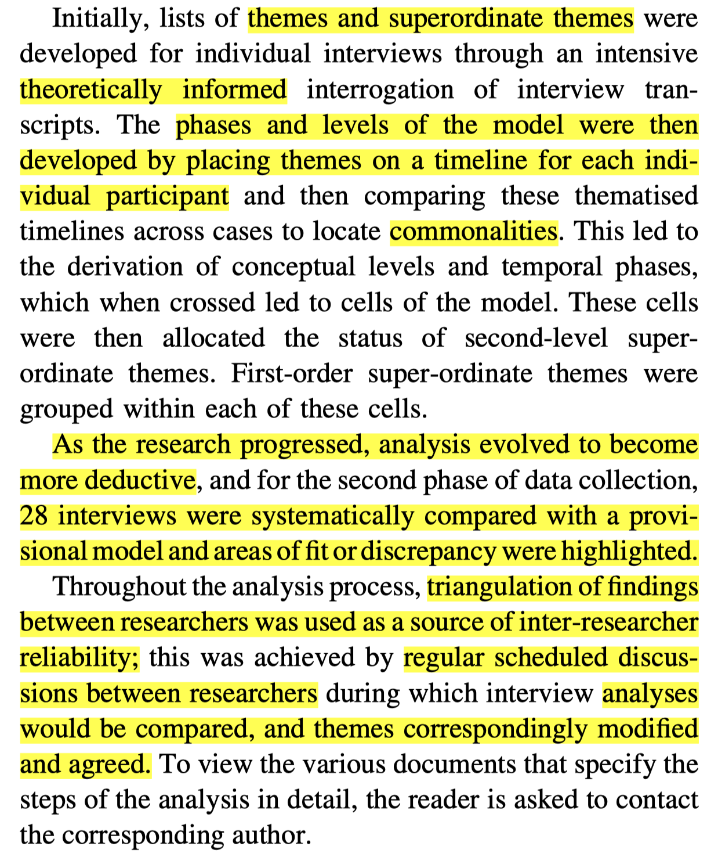
Coding (Robinson2103a?)

Slide 29
Ethnography - The study of Groups 1
Definition: Ethnography is the in-depth study of a group and its culture over an extended period. Derived from Greek ‘ethnos’ (nation or group) and ‘graph’ (writing), it’s a key method in cultural anthropology and other social sciences.
Focus:
Everyday behaviors, interactions, language, and rituals of a group.
Cultural norms, beliefs, practices, social structures, and patterns.
Both explicit (observable) and implicit (subconscious) cultural elements.
Applications:
Originally used in anthropology, now applied in education, social sciences, marketing + Psych.
Studies diverse cultures, from traditional societies to modern online communities.

Slide 30
Ethnography - The study of Groups 2
Fieldwork Essentials:
Prolonged engagement in the group’s natural setting for authentic observation.
Gaining access through gatekeepers, establishing rapport, and ensuring informed consent.
Balancing roles from an outside observer to an immersed participant, maintaining objectivity.
Data Collection:
Participant observation, interviews, extensive field notes, and collection of artifacts.
Critical ethnographies focus on marginalized groups, seeking transformative insights.

Slide 31
Ethnography - The study of Groups 3
Note:
Ethnography requires a balance between involvement and objectivity.
Ideal for researchers interested in the complexities of sociocultural dynamics.
Can be adapted:
e.g. Video-Reflective Ethnography
Reference: (parker2004?) http://ndl.ethernet.edu.et/bitstream/123456789/14598/1/1428.pdf
and Atkinson et al. (2014)

Slide 32
Diary Studies in Qualitative Research 1
Overview:
Diary studies involve participants keeping regular records of their daily lives, experiences, thoughts, and feelings.
These records provide real-time, first-person accounts, offering rich, contextual insights.
Methodology:
Participants are asked to record entries over a set period, which can range from days to months.
Diaries can be structured with specific prompts or unstructured, allowing free expression.
Applications in Psychology:
Useful for studying patterns in behavior, mood, social interactions, and psychological states.
Provides a longitudinal perspective, capturing changes and developments over time.

Slide 33
Diary Studies in Qualitative Research 2
Advantages:
Captures data in participants’ natural environments, leading to high ecological validity.
Offers a deeper understanding of subjective experiences and daily life contexts.
Enables the study of phenomena as they occur, reducing recall bias.
Challenges:
Relies on participant commitment and honesty in regular entries.
Data can be voluminous and varied, requiring careful and sensitive analysis.
Potential issues with privacy and ensuring confidentiality of personal records.
Tips:
Engage the participant with the study’s purpose and diary guidelines to participants.
Attrition is HUGE.
Be prepared for a detailed and nuanced analysis of the diary entries (qual AND quant).
Consider alternatives such as Experience Sampling, or Day Reconstruction Silvia & Cotter (2021)

Slide 34
Any Questions?

Slide 35
References
Atkinson, P., Coffey, A., Delamont, S., Lofland, J., & Lofland, L. (Eds.). (2014). Handbook of ethnography (Reprinted). SAGE.
Levine, T. R. (2010). A Few Transparent Liars Explaining 54. Annals of the International Communication Association, 34(1), 41–61. https://doi.org/10.1080/23808985.2010.11679095
Robinson, O. C., & Wright, G. R. T. (2013). The prevalence, types and perceived outcomes of crisis episodes in early adulthood and midlife. International Journal of Behavioral Development, 37(5), 407–416. https://doi.org/10.1177/0165025413492464
Robinson, O. C., Wright, G. R. T., & Smith, J. A. (2013). The Holistic Phase Model of Early Adult Crisis u1 - robinson2013a. Journal of Adult Development, 20(1), 27–37. https://doi.org/10.1007/s10804-013-9153-y
Silvia, P. J., & Cotter, K. N. (2021). Researching daily life: A guide to experience sampling and daily diary methods. American Psychological Association.

